Slide 1


Giveaway Stuff
Intro
Overview
Problem
Objectives
Tools
Diagrams
Every Day is the Giveaway Day
Giveaway
www.giveawaystuff.com.pk

Slide 2
Final Year Project - Capstone # II
Giveaway Stuff
Intro
Overview
Problem
Objectives
Tools
Diagrams
Project Advisor
Mr. Abdul Jamil
Submitted by
Ali Raza F2019105036
M. Murtaza Arshad F2019065101
M. Usman Ghani F2019266154
Where everyone has the option to give and take stuff at any time ⌚ and anywhere.
Giveaway
www.giveawaystuff.com.pk

Slide 3

A "Giveaway Stuff" is the concept where people hang extra and unneeded items like clothing and shoes outside their homes.
Giveaway Stuff
Intro
Overview
Problem
Objectives
Tools
Diagrams
Idea
Where everyone has the option to give and take stuff at any time ⌚ and anywhere.
Giveaway
www.giveawaystuff.com.pk

Slide 4

Project Overview
Giveaway Stuff
Intro
Overview
Problem
Objectives
Tools
Diagrams
Giveaways like furniture, clothing, electronics, stationary, kitchenware, shoes, and other household and workplace supplies, etc
Giveaway
www.giveawaystuff.com.pk

Slide 5

Project Overview
Giveaway Stuff
Intro
Overview
Problem
Objectives
Tools
Diagrams
Users will first write the specific information about the item and post whom they wish to give away. And another user will now see the post and contact the first user.
Giveaway
www.giveawaystuff.com.pk

Slide 6

Problem Statement
Intro
Overview
Problem
Objectives
Tools
Diagrams
Giveaway Stuff
Problem
If the user moves to another place and wants to give the extra stuff to others. If another user is unable to get the desired Stuff.
Giveaway
www.giveawaystuff.com.pk

Slide 7

Project Objectives
Giveaway Stuff
Intro
Overview
Problem
Objectives
Tools
Diagrams
To Develop a Web/App.
UI is classic and user-friendly.
Easy to navigate.
Create a post with info like pictures and descriptions, properties, etc.
Chat between sender and receiver.
Provide the platform to the people that share unnecessary stuff with the person who may need it free of cost.
Giveaway
www.giveawaystuff.com.pk

Slide 8

Project Tools ⚙
Giveaway Stuff
Intro
Overview
Problem
Problem
Tools
Diagrams
React JS
Firebase
Flutter
Android Studio
Giveaway
www.giveawaystuff.com.pk

Slide 9

Project Diagram
Giveaway Stuff
Intro
Overview
Problem
Problem
Tools
Diagram
Use Case Diagram
DFD Level 0
System Architecture
Class Diagram
Sequence Diagram
Collaboration Diagram
ERD
Data Dictionary
Giveaway
www.giveawaystuff.com.pk

Slide 10
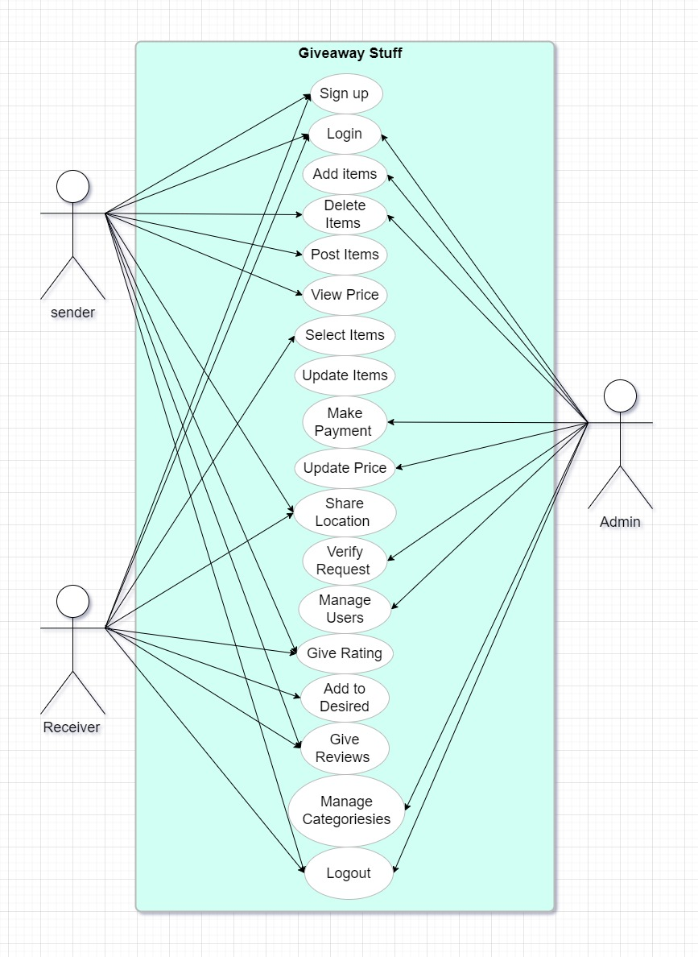

Use Case Diagram

Slide 11
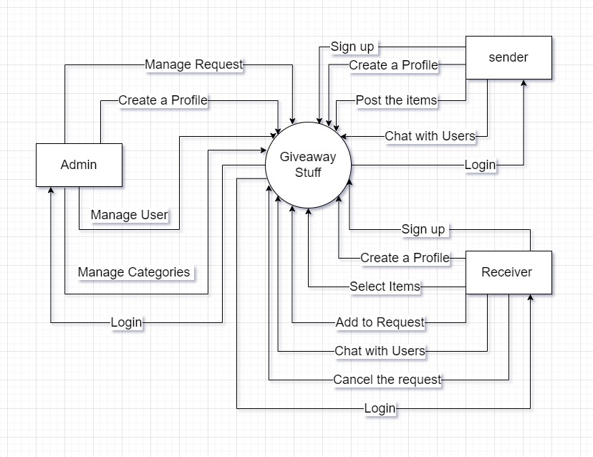
Data Flow Diagram Level 0

Slide 12
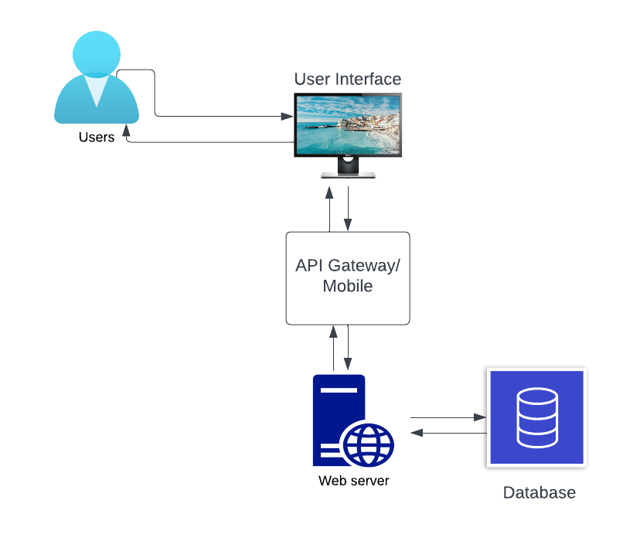
System Architecture Diagram

Slide 13
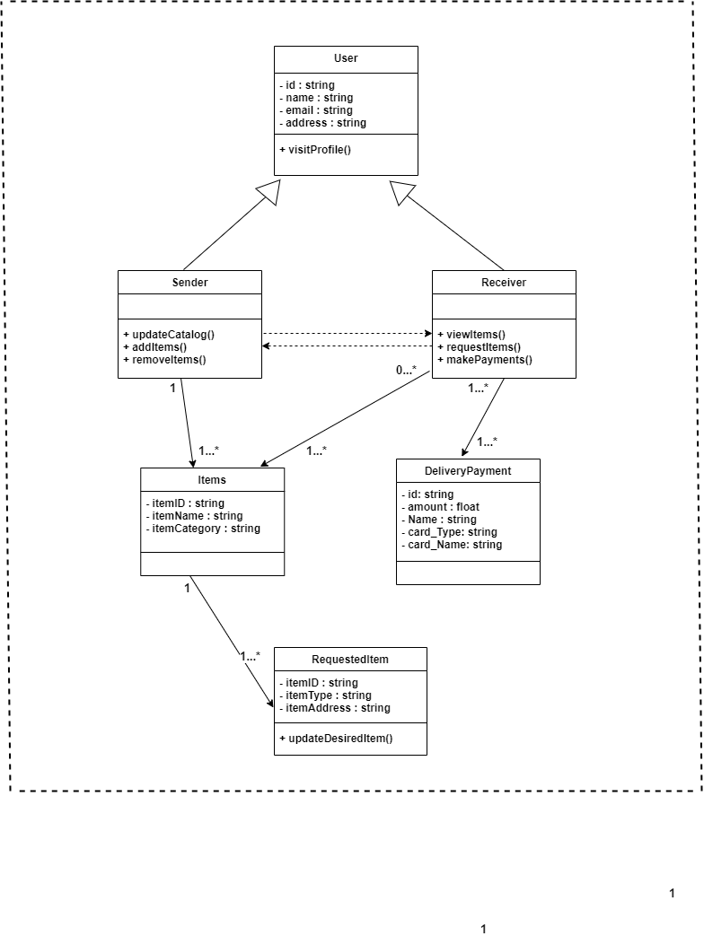
Class Diagram

Slide 14
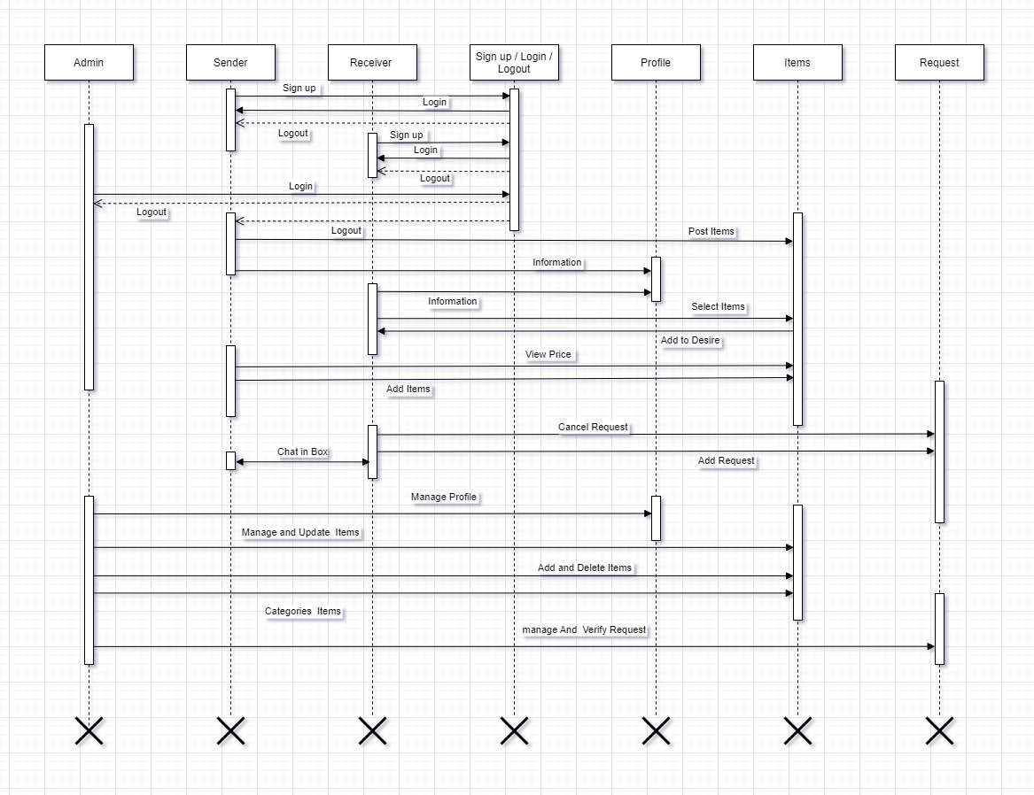
Sequence Diagrams

Slide 15
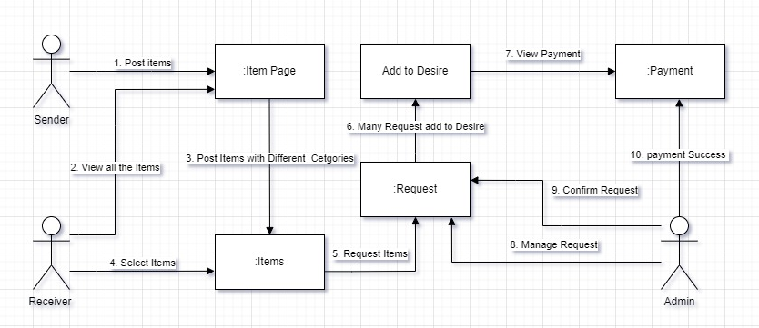
Collaboration Diagrams

Slide 16
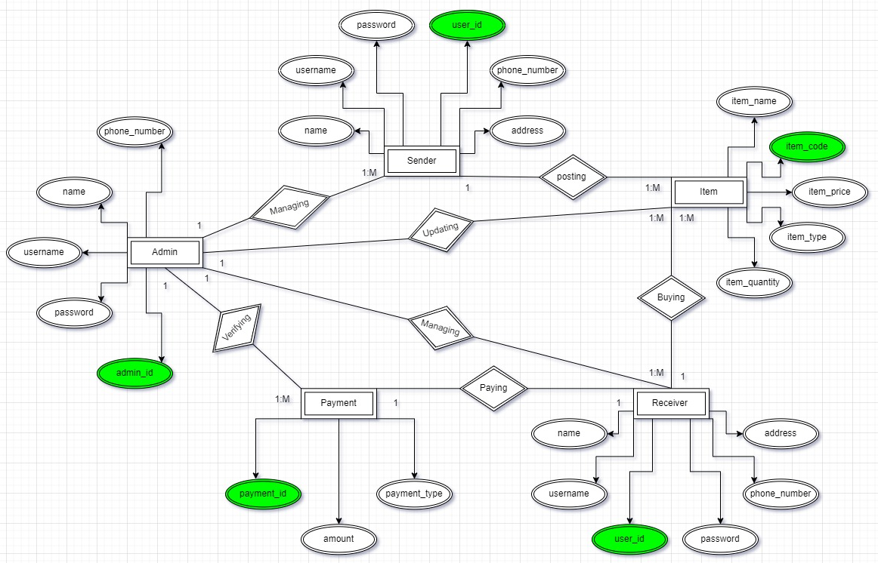
ERD

Slide 17
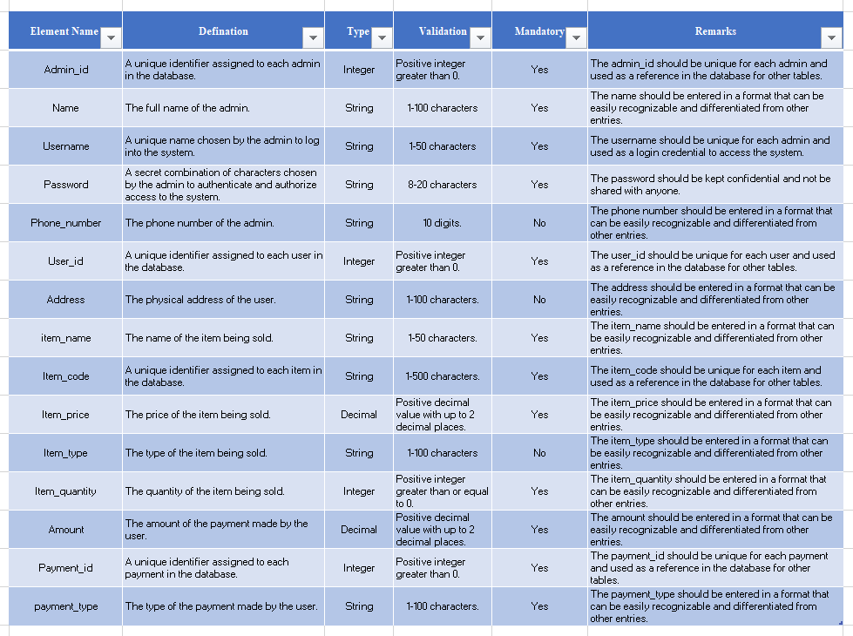
Data Dictionary

Slide 18

Development Setup ⚙
Giveaway Stuff
Intro
Overview
Problem
Problem
Setup
Diagrams
React.js
Android Studio
Flutter
Firebase DB
Giveaway
www.giveawaystuff.com.pk

Slide 19

Project Algorithm
Giveaway Stuff
Intro
Overview
Problem
Algorithm
Tools
Diagrams
Recommender System
Search algorithm
Authentication Protocol
Data Filtering
Giveaway
www.giveawaystuff.com.pk

